Slide 1
Collaborative Work tools
Bruno Gustavo Chagas and Felipe Soares

Slide 2
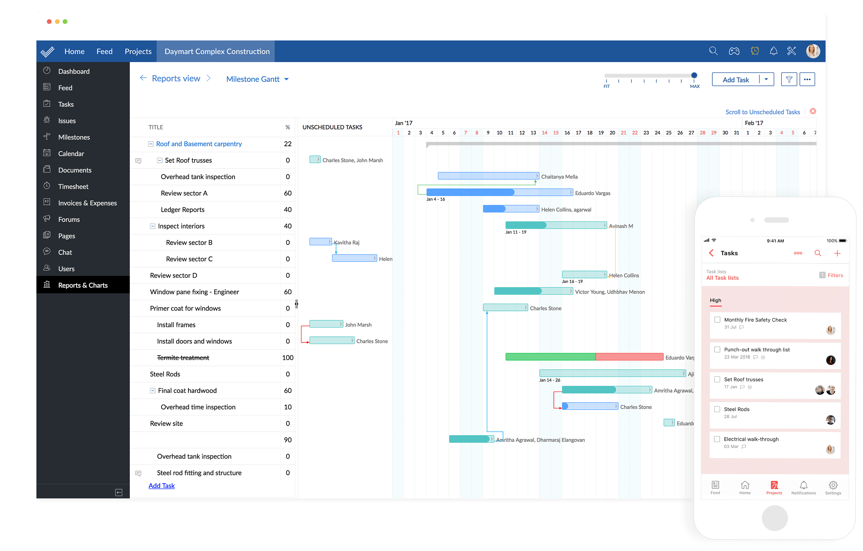
Zoho Projects

Slide 3
Zoho Project
Management work.
Shared tasks.
Team progress.
Mobile app.

Slide 4
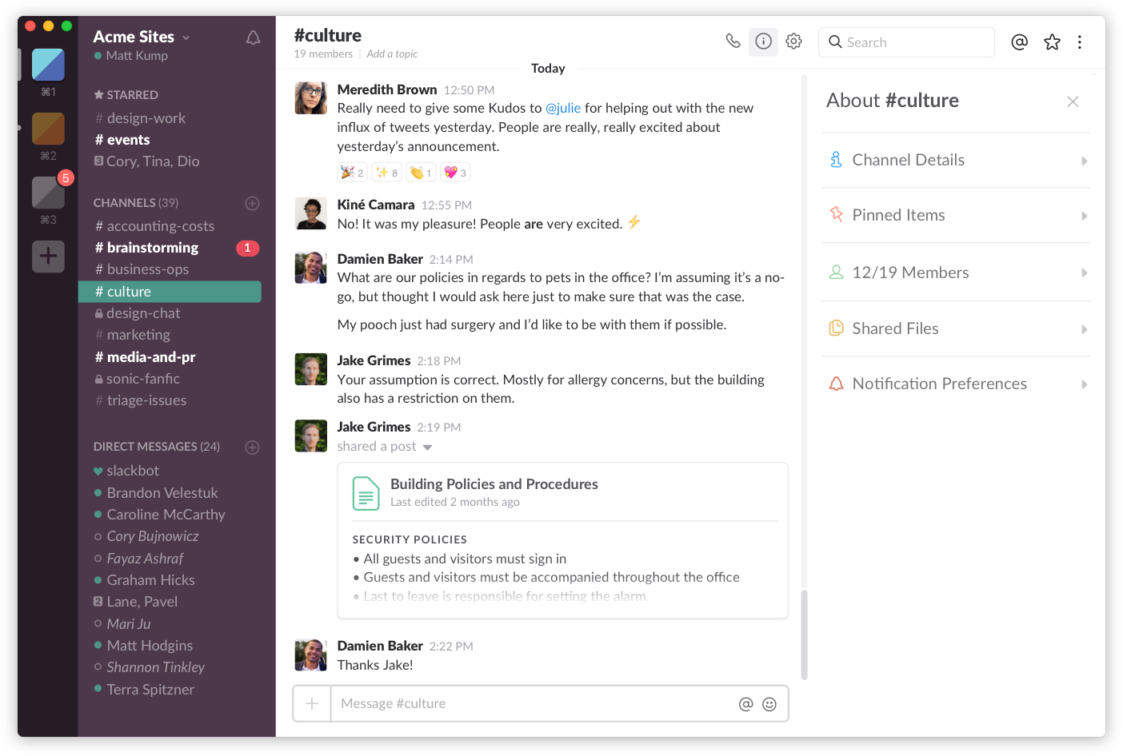
Slack

Slide 5
Slack
Messages.
Channels.
Shared files.
Everything is searchable.
Mobile app.

Slide 6
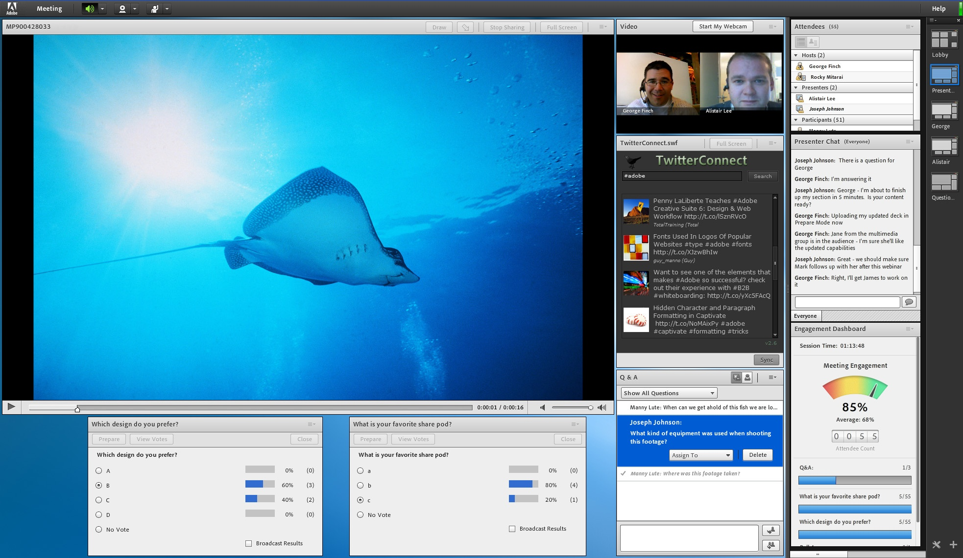
Adobe Connect

Slide 7
Adobe Connect
Conferencing software.
Online meetings.
Online classes.
Shared files.
Mobile app.

Slide 8
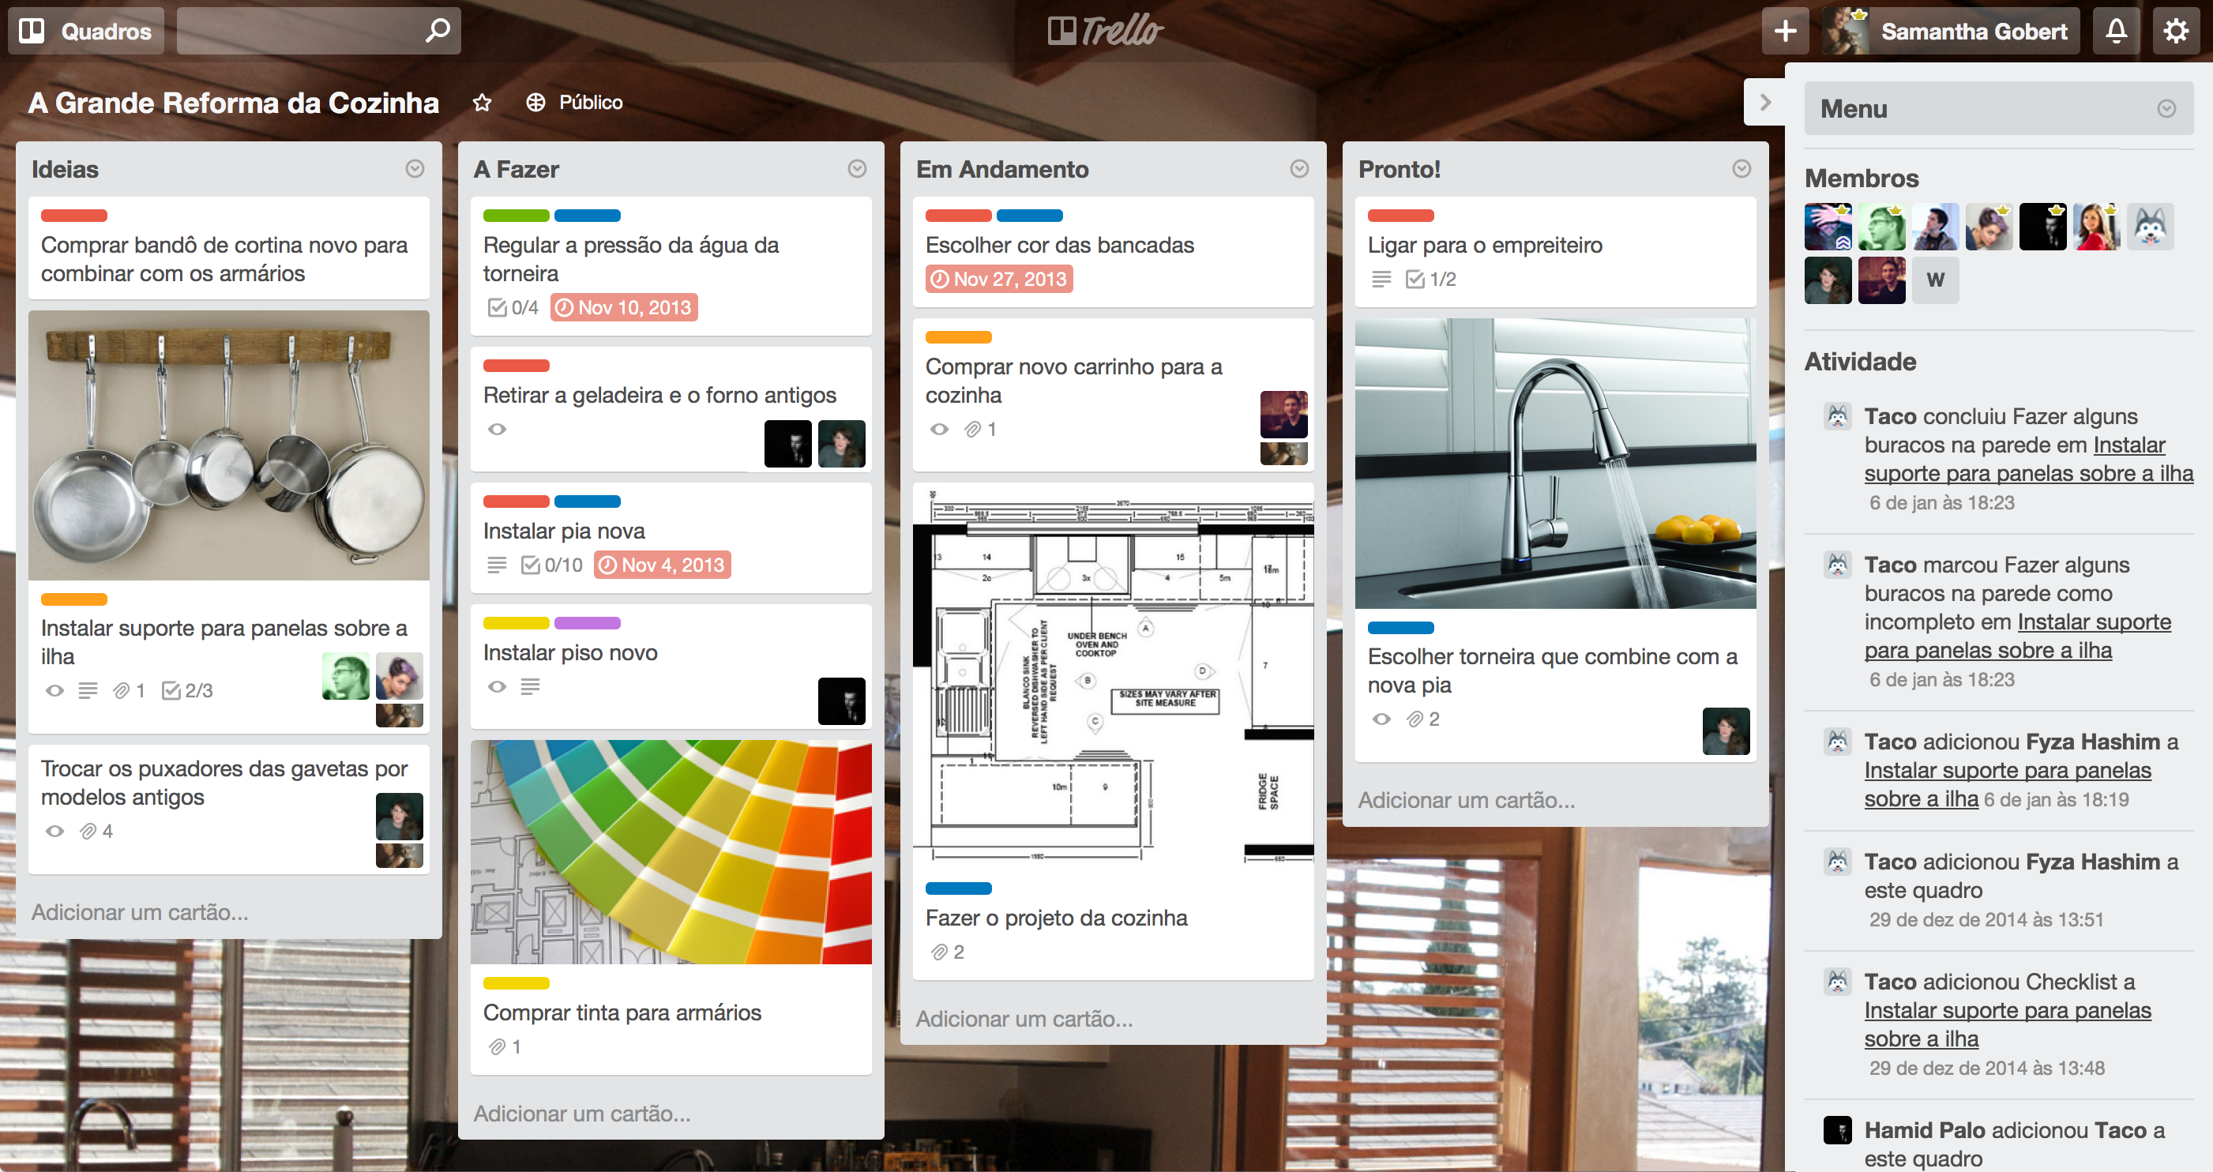
Trello

Slide 9
Trello
Project management application.
Cards organized.
Mobile app.

Slide 10
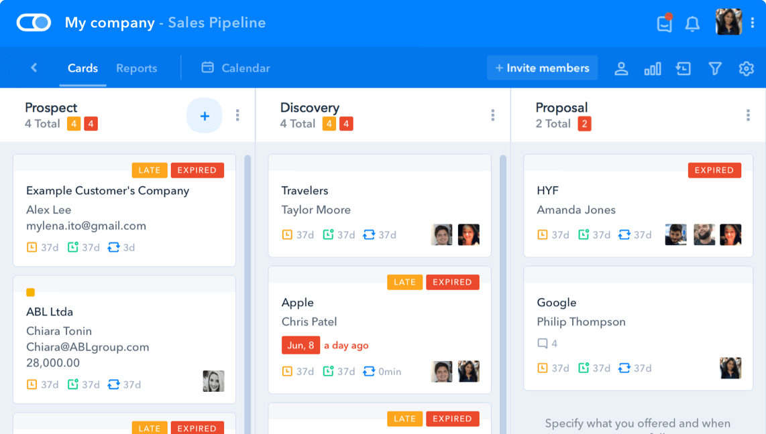
Pipefy

Slide 11
Pipefy
Project management application.
Workflows management.
Cards organized.
Mobile app.

Slide 12
Collaborative Work tools
Bruno Gustavo Chagas and Felipe Soares

